Slide 1
Neighborhood Update RW-21 Area Remedial Design/Remedial Action
0
–
Operable Unit 3 – Bethpage, New York October 13, 2016
©Northrop Grumman 2016
Approved for public release, NG16-2042, 10/12/16

Slide 2
Overview – Why are we here?
New York State has approved Northrop Grumman’s plan to clean up groundwater quality, which will benefit the community
Project Overview
Review of Schedule
Response to Comments
Project contact for more information
Northrop Grumman, New York State DEC and DOH,
and Nassau County DOH representatives
are here to answer your questions
Approved for public release, NG16-2042, 10/12/16

Slide 3
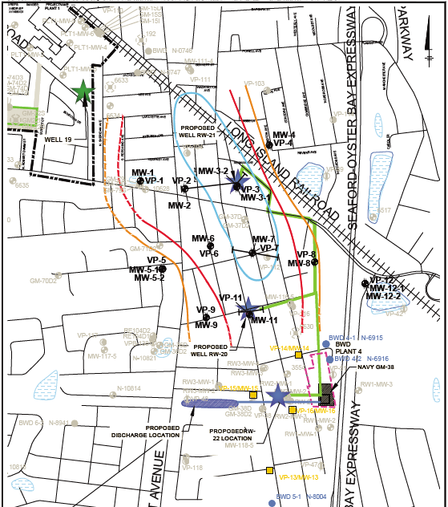
Project area
Width of Area of VOC Mass
Proposed Remedial Well
Approved Remedial Well
Approved Boring/Monitoring Well
Plume Contours, ug/L
500
1,000 5,000
Approved for public release, NG16-2042, 10/12/16

Slide 4
Key Elements of the Cleanup System
Three Groundwater Remedial Wells
Below-ground vaults for wells installed to extract groundwater
Groundwater pumped to treatment system in buried pipes
Treatment System
Removes contamination from the groundwater
Includes water and air treatment, and other required equipment
Discharge Pipe
Clean water from treatment system pumped to new recharge basin near Arthur Avenue or to the existing basin on Arthur Avenue
Approved for public release, NG16-2042, 10/12/16

Slide 5
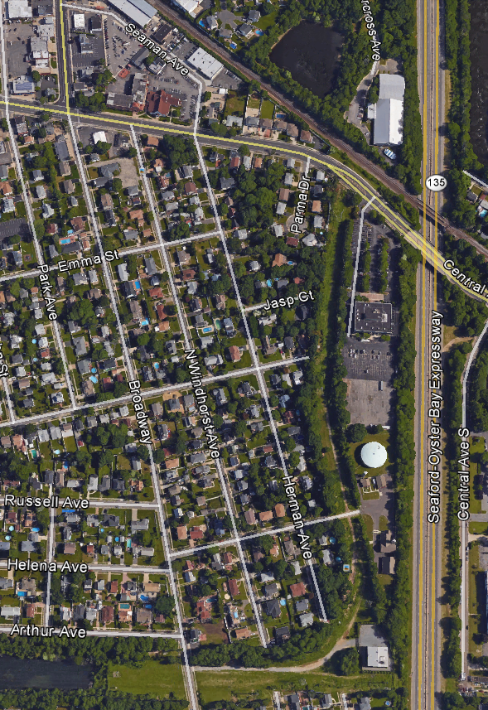
Project Overview
RW-21
NYSDEC- approved, TOB permitted well
NYSDEC-approved, TOB permit-pending well
New Treatment Building
New buried treated water line and flow direction
RW-20
New buried pipe location
New Building Near GM-38 Treatment Plant
Existing Navy GM-38 buried treated water line and flow direction
Arthur Avenue Basin
Proposed
New Basin
RW-22
Approved for public release; NG16-2042, 10/12/16
©Northrop Grumman 2016
Notes:
Mention 2 phases of pipe installation:
Install pipe stubs and vaults at the same time as the remedial well
Install remainder of pipes, install electric, pumps, plumbing, and complete development of the remedial well.

Slide 6
Expedited Schedule
Completing some steps in parallel reduces timeline & community disruption
Permitting & Access Agreements
Remedial Design
PERMITTING
& DESIGN
Design Studies
(Borings & Surveying)
Purchase Remedial System Equipment
APR
JUL
OCT
JAN
APR
JUL
Start
Up
2016
2017
Install RW-21 & RW-22
Install RW-20
Install VPBs & Monitoring Wells
Build Treatment Plant
CONSTRUCTION
Build New Basin
Install Piping & Vaults
Install
Discharge Line
Water won’t be pumped through system until Start-Up!
Approved for public release, NG16-2042, 10/12/16

Slide 7
Summary of Comment Topics
RW-20
Safety and Security
Temporary Power, Plans to Mitigate Noise, Dust, and Vibration
Site Restoration
Engagement with Bethpage School District transportation officials
Basins
Capacity
Maintenance Activities
Treatment System
Source of Electric Power
Vault Excavation/Installation Method
Utilities
Coordination for Use of Municipal Lot near St. Martin of Tours
Site Restoration
Approved for public release, NG16-2042, 10/12/16

Slide 8
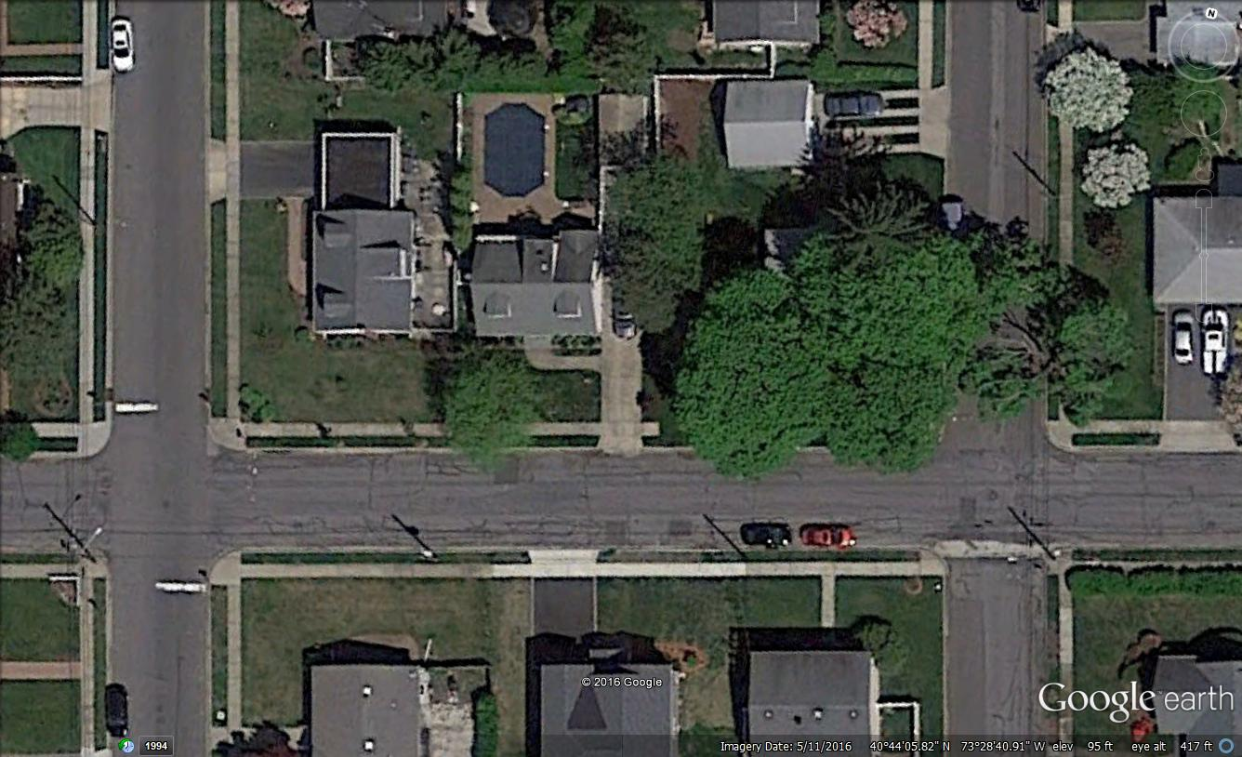
Re-Configuration of RW-20 Work Zone
We reduced the work zone and relocated well on to William Street. This solution no longer blocks traffic on Broadway, but requires an additional 4 weeks.
N
N. Windhorst Ave.
Proposed Temporary Power
Pole and Service Relocation
Transplanted Trees
Tree
Requiring
Pruning
William St.
Proposed Well
Smaller work area reduces impact to community.
Broadway
Approved for public release; NG16-2042, 10/12/16
©Northrop Grumman 2016

Slide 9
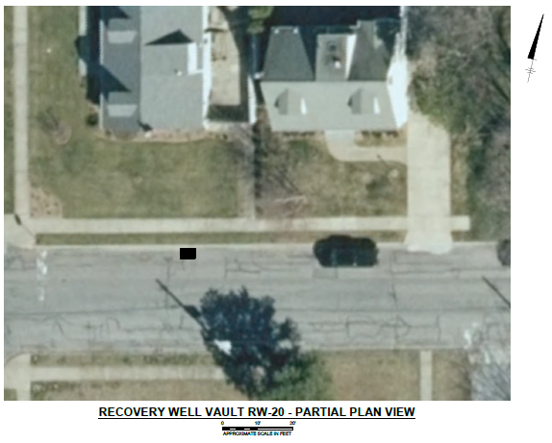
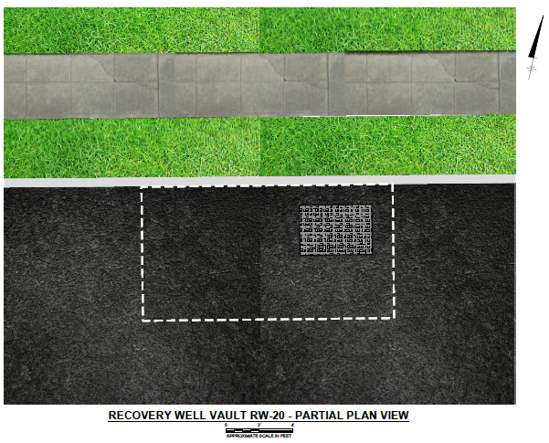
New RW-20 Well and Vault Location
Side lawn of 160 Broadway
Sidewalk
Town Right-of-Way
Well Vault Outside Edge
Well Vault Access Hatch
Well Vault Access Hatch
Re-Located Gas Line
William Street
Approved for public release, NG16-2042, 10/12/16

Slide 10
Safety, Security, Controls, Work Hours, Engagement
Our plan includes health, safety and security measures to protect our community and our site workers
SAFETY work materials will be contained; excess materials removed each day
SECURITY for workers and residents throughout the project (including while school in session)
CONTROLS minimize inconvenience to residents and businesses
WORK HOURS are done in accordance with town code.
COMMUNITY ENGAGEMENT open door policy with residents, officials
Established
bi-weekly project review meetings with NY State and Town experts
Goal: Expedited Schedule to Reduce Neighborhood Impact
All work is coordinated with NYSDEC, State and County DOHs, and Town of Oyster Bay
Approved for public release; NG16-2042, 10/12/16
©Northrop Grumman 2016

Slide 11
Contact Information
Mr. Steven Scharf, P.E. Project Manager NYSDEC Main Office: (518) 402-9620, Ext 3. E-mail: steven.scharf@dec.ny.gov
Mr. William Fonda Citizen Participation Specialist NYSDEC Public Affairs & Education Main Office: (631) 444-0347 E-mail: Bill.Fonda@dec.ny.gov
Mr. Steven Karpinski NYS Department of Health Main Office: (518) 402-7853 E-mail: steven.karpinski@health.ny.gov
If you have questions or concerns, please contact these New York State project representatives:
©Northrop Grumman 2016
Approved for public release, NG16-2042, 10/12/16

Slide 12
Contact Information
If you wish to contact Northrop Grumman directly, please contact:
Ms. Dianne Baumert-Moyik Communications Northrop Grumman Cell Phone: (516) 754-2645 E-mail: Dianne.Baumert-Moyik@ngc.com
Please sign the attendance sheet with your email and phone number as you leave, so that we can provide you with updates on project status.
©Northrop Grumman 2016
Approved for public release, NG16-2042, 10/12/16

Slide 13
Thank You
Please pick up a fact sheet as you leave
©Northrop Grumman 2016
Approved for public release, NG16-2042, 10/12/16

