Slide 1
Westchester Garden Center-Labriola Landfill and Armonk Private Wells Site
Per- and Polyfluoroalkyl Substances in Water Sources
Overview, Information & Resources
Availability Session
NYSDEC Site Nos. 360218 & 360005 October 27, 2022

Slide 2
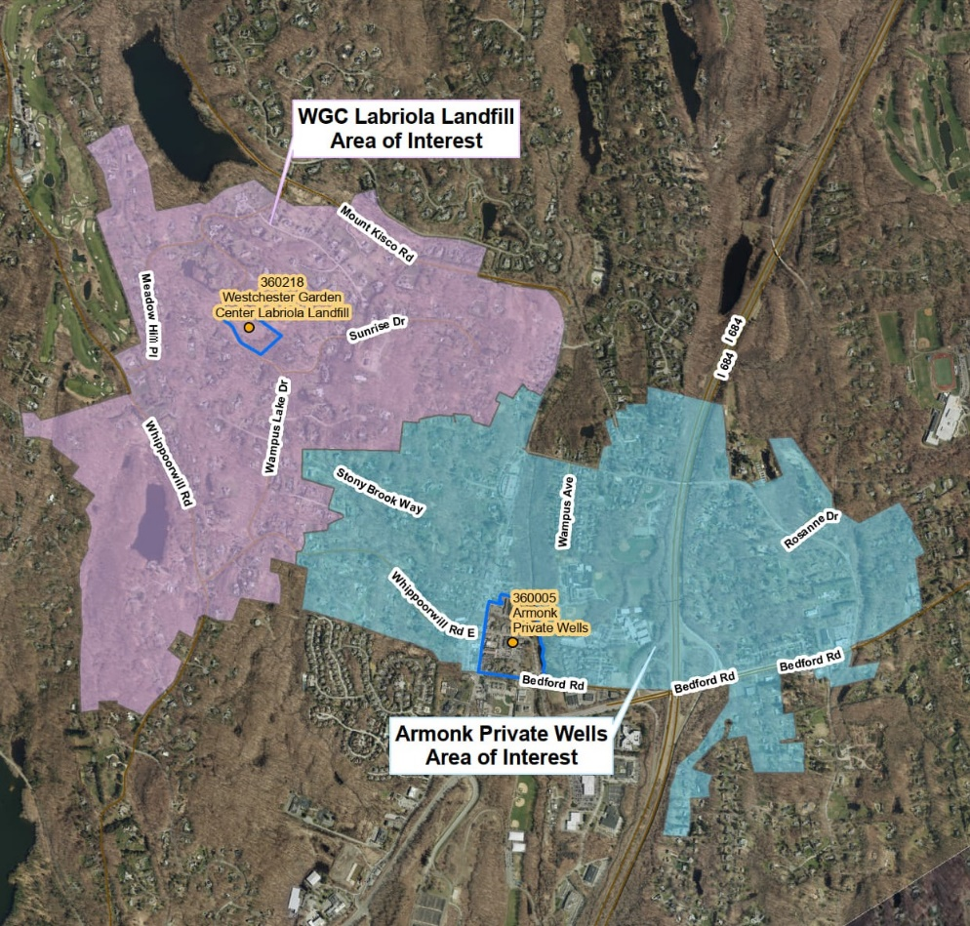
Background (1 of 3)
As part of NYS's Emerging Contaminant Sampling Initiative and Inactive Landfill Initiative to investigate groundwater at new and legacy sites, DEC collected samples for per- and polyfluoroalkyl substances (PFAS) in groundwater and private drinking water supply wells around two sites: Westchester Garden Center/Labriola Landfill and Armonk Private Wells Site.
Site Boundaries
Armonk Private Wells Site Area of Interest
WGC Labriola Landfill
Area of Interest

Slide 3
Background (2 of 3)
Perfluorooctanoic acid (PFOA) and perfluorooctanesulfonic acid (PFOS) were detected in groundwater and drinking water supply wells above NYS's maximum contaminant levels (MCLs) for public drinking water (10 parts per trillion).
PFAS is not regulated in private wells.
NYS uses public drinking water standards as guidance when evaluating private well data and recommending actions to reduce exposure.

Slide 4
Background (3 of 3)
Water supply well sampling and alternate water supplies (if needed based on results) are available at no cost to property owners within the currently defined areas of interest.
Additional efforts are underway to determine the potential sources of PFAS contamination in the area.

Slide 5
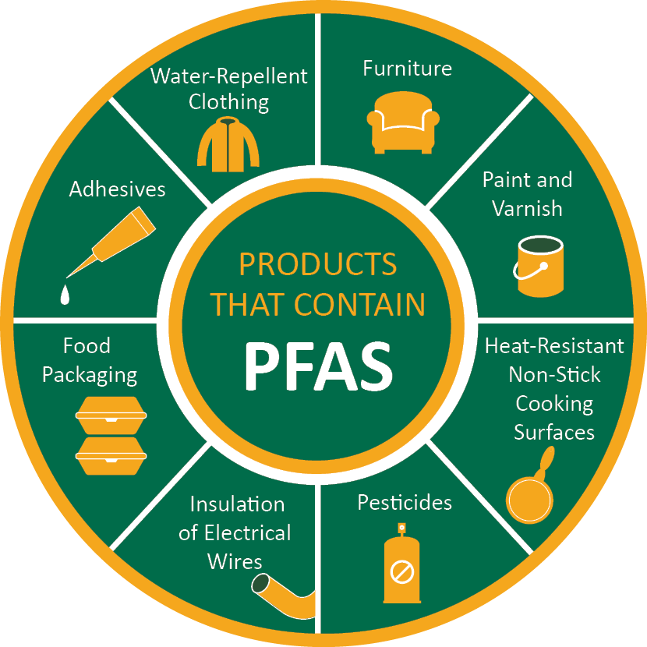
What are PFAS?
PFAS are a group of manufactured chemical compounds used for decades in industry and consumer products.
PFAS are widely used, long-lasting, and break down slowly over time.

Slide 6
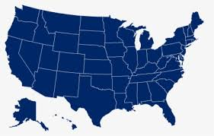

PFAS – Why the concern? (1 of 3)
PFAS are commonly found in the environment and have been detected in public drinking water and in private wells around NY and the US.

Slide 7


PFAS – Why the concern? (2 of 3)
Most of what is known about health effects comes from studies of high-level exposure in animals.
Less is known about human health effects occurring from lower levels of PFAS exposure, such as from drinking water.

Slide 8


PFAS – Why the concern? (3 of 3)
Finding lower levels of chemicals in drinking water prompts DOH and DEC to make recommendations that people take steps to reduce exposures.

Slide 9
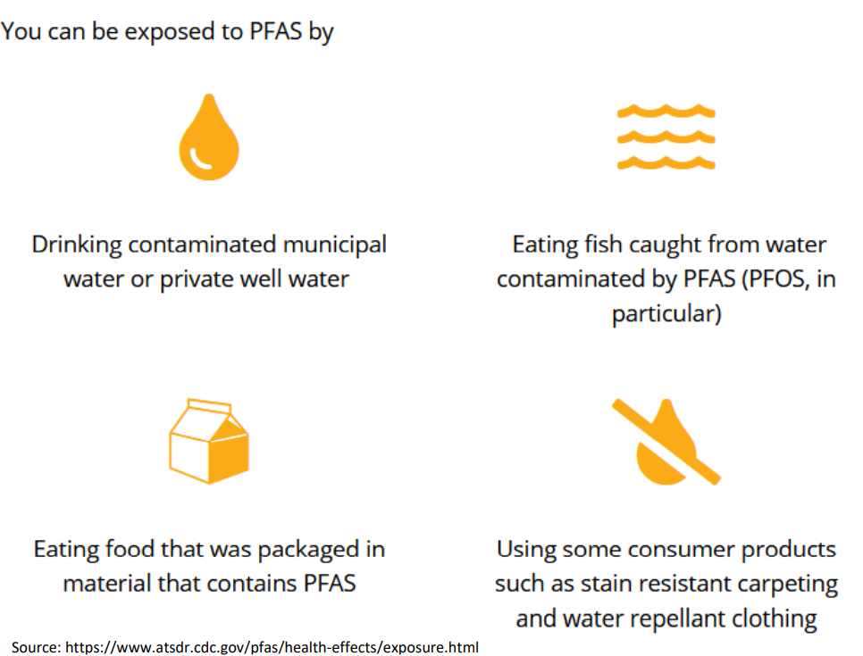
How can I be exposed?
You can be exposed to PFAS by:
Drinking contaminated water

Slide 10
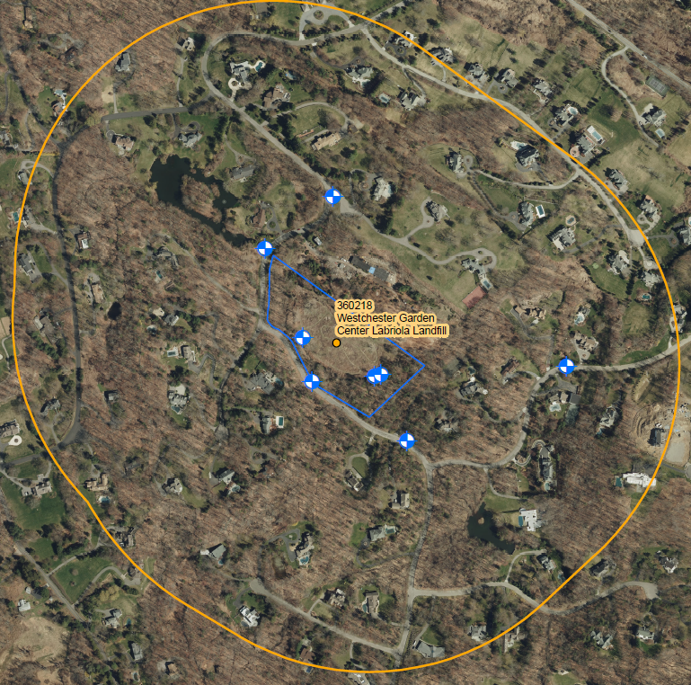
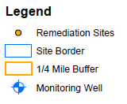
Westchester Garden Center-Labriola Landfill
Division of Materials Management
Inactive Landfill Initiative
  PFOA and PFOS detected above the drinking water MCLs in one monitoring well
  PFOA/PFOS impacts to private drinking water supplies found
Division of Environmental Remediation
  Designated the landfill as a potential hazardous waste site (P-Site) requiring further investigation
  Site Characterization activities completed in the summer of 2022; data currently under review

Slide 11
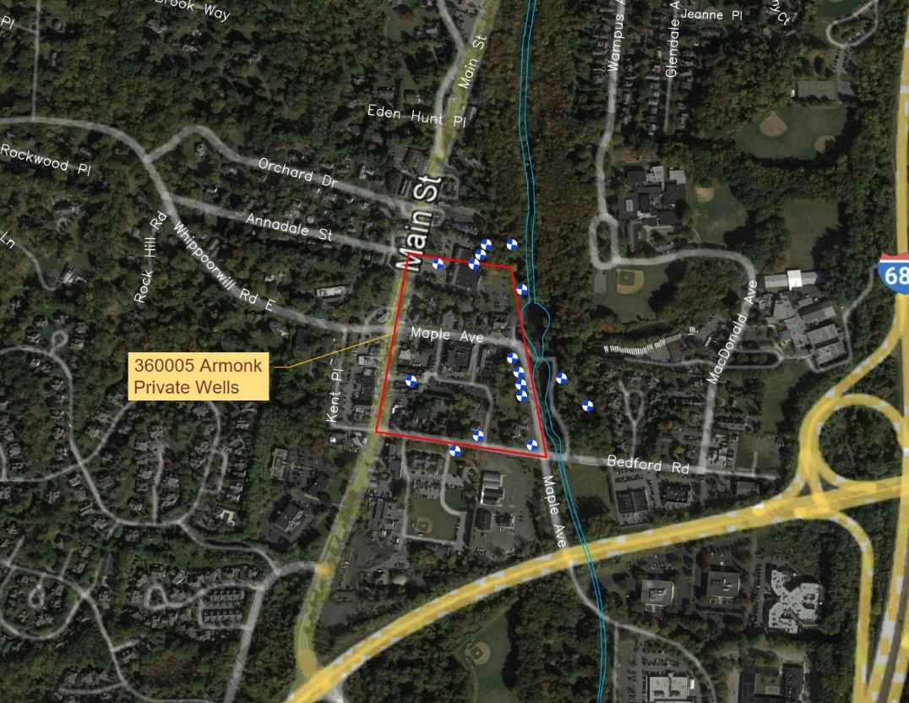

Armonk Private Wells
During survey of State Superfund Sites for emerging contaminants, PFOA and PFOS were detected in groundwater monitoring wells at the Armonk Private Wells State Superfund Site
The discovery of PFOA and PFOS in a water supply aquifer above MCLs led to a wider investigation in Armonk
Legend
Monitoring well
Site Boundary

Slide 12
Private Water Supply Sampling
DEC and DOH surveyed the surrounding area for private water supplies.
Private well sampling began at properties closest to the Westchester Garden Center/Labriola Landfill and Armonk Private Wells site.
Site Boundaries
Armonk Private Wells Site Area of Interest
WGC Labriola Landfill
Area of Interest

Slide 13







Potential Sources of PFAS in North Castle
Discharges to septic systems
Sewer system leaks
Car maintenance
Potential historic fires

Slide 14
PFAS Source Investigation – WGC Labriola Landfill
ACTIONS | STATUS / SCHEDULE
Sampling and evaluation of private well PFAS data | Ongoing
Site characterization | Ongoing
Field work | Completed
Data review/validation | In progress
Site characterization report | In progress

Slide 15
PFAS Source Investigation – Armonk Private Wells
ACTIONS | STATUS / SCHEDULE
Evaluation of potential PFAS sources | Ongoing
Evaluation of private well PFAS data | Ongoing
Sampling of surface water and sediment near potential PFAS sources | Scheduled for fall 2022
Sampling of groundwater near potential PFAS sources | Scope in development

Slide 16
Private Water Supply Sampling Status - WGC Labriola Landfill
At 59% of sampled properties in the vicinity of WGC Labriola Landfill, alternate water supplies have been provided.

Slide 17
Private Water Supply Sampling Status – Armonk Private Wells Site
At 51% of sampled properties in the vicinity of the Armonk Private Wells Site, alternate water supplies have been provided.

Slide 18
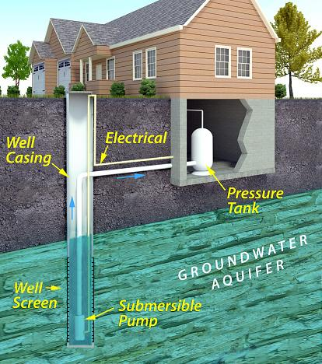
Your water could be from a private well if…
You have a water pump and a well on your property for your drinking water system
You do not receive a water bill
You have a septic system
Image courtesy of U.S. EPA (https://19january2017snapshot.epa.gov/privatewells/about-private-water-wells_.html)

Slide 19
PFAS – Are There Drinking Water Standards?
DOH regulates PFOA and PFOS in public water supplies through drinking water standards or Maximum Contaminant Levels (MCLs).
The MCLs for PFOA and PFOS are set at 10 parts per trillion (ppt) each for public water supplies.
These standards are among the lowest in the country and are intended to protect against health effects.

Slide 20



Private Well Sampling for PFAS
If your property is in the area of interest and you would like to have your private water supply well sampled for PFAS, please contact the DEC hotline provided in the letter you received in the mail or email:
NorthCastleWellSampling@gmail.com
The sampling is performed at no cost to you and can be arranged based on your schedule.
Typically, drinking water samples will be collected from your kitchen tap in two small bottles and submitted to a certified laboratory for PFAS analysis.

Slide 21





When Will I Get My Private Well Results? (1 of 2)
The laboratory typically provides the results to DEC/DOH one month after the sample is collected.
DOH will contact you to discuss your sampling results and will provide you with a copy of the lab report.
DEC/DOH

Slide 22
When Will I Get My Private Well Results? (2 of 2)
If your private well is in the area of interest and has sampling results at or above 10 parts per trillion (ppt) for PFOA or PFOS, DEC will contact you to:
Provide bottled water (alternate water supply).
Offer a point-of-entry treatment (POET) system.
For PFOA or PFOS results below 10 ppt, DEC/DOH may resample your well at some point in the future.
DEC/DOH Review Results
At or above
10 ppt
Below 10 ppt
Bottled Water
No Action*
Offer POET to Homeowner
* DEC/DOH may resample to confirm result after 6 months

Slide 23
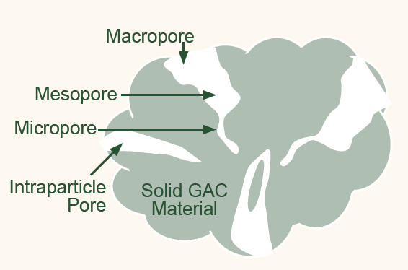
Point-of-Entry Treatment (POET) System - Activated Carbon Filtration
Use of activated carbon, commonly referred to as GAC (granular activated carbon) is a well-established approach for purifying water.
Sketch of GAC Particle

Slide 24
Activated Carbon Filtration – How it Works
PFAS molecules become trapped in the pores within GAC particles by a process called adsorption.
Microscopic Image of GAC Surface

Slide 25
Activated Carbon Filtration – How it’s used
GAC is typically housed in cylindrical containers referred to as vessels.
Water is pumped through the activated carbon in the vessels to accomplish treatment.
GAC Treatment Vessel Examples

Slide 26
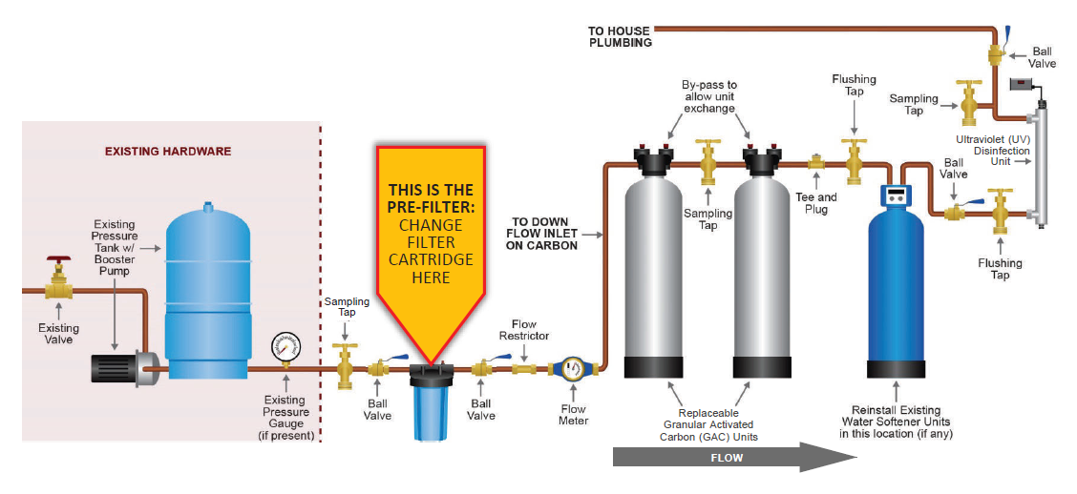

Point-of-Entry Treatment (POET) Systems
Typical POET Installation
POET Systems Filter All of the Well Water that enters a Residence

Slide 27
How Does a POET Look When Installed?
Typical Household POET Installation
Outgoing Treated Water
Pre-Filter with Replaceable Cartridge
Existing Hardware
Pressure Tank
Booster Pump
Ultraviolet (UV) Disinfection Unit
Replaceable Granular Activated Carbon Units
Incoming Well Water

Slide 28
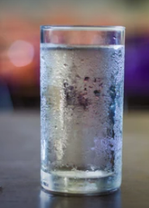
Overall Benefits of POET Water Treatment
Reliable – Established and effective technology
Safe – Removes PFAS, micro-organisms, and other contaminants
Improves Water Quality – Decreases cloudiness and improves taste, odor and color

Slide 29
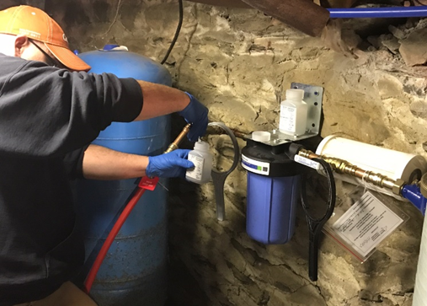
Monitoring to Confirm Reliable Treatment
Effective treatment supplemented by periodic testing of treated water.
Testing enables operational adjustments and confirmation of effectiveness.
NYSDEC Engineering Contractor Sampling Filtered Water

Slide 30


POET Systems – No Cost Maintenance
Homeowners are not responsible for installation, maintenance, or sampling costs.
Continues until testing indicates well water treatment is no longer necessary.

Slide 31

For additional information, visit our website:
https://www.dec.ny.gov/chemical/126339.html
En Español: https://es.dec.ny.gov/chemical/126339.html
Latest information
Resources
Public involvement opportunities
Contact information

Slide 32


NYSDEC Contact Information (1 of 3)
Site Investigation
For inquiries related to surface water, groundwater and drinking water sampling, and PFAS source evaluation:
Jasmine Stefansky – Armonk Private Wells Site Project Manager
NYSDEC
(518) 402-9575 | Jasmine.Stefansky@dec.ny.gov
Brittany O’Brien-Drake – WGC Labriola Landfill Project Manager
NYSDEC
(518) 402-9672 | Brittany.OBrien-Drake@dec.ny.gov

Slide 33
NYSDEC Contact Information (2 of 3)
Private Well Sampling
To determine if your property is located within the area of interest, and therefore eligible for sampling, contact DEC’s environmental engineering consultant at the North Castle PFAS Information e-mail:
NorthCastleWellSampling@gmail.com

Slide 34
NYSDEC Contact Information (3 of 3)
POET Systems & Alternate Water Supplies
For questions related to the provision of an alternate water supply (i.e., bottled water, POET systems, or public water supply connections):
David Chiusano
NYSDEC
(518) 402-9813 | David.Chiusano@dec.ny.gov

Slide 35
NYSDOH Contact Information
Health-Related Inquiries
For health-related inquiries, please reach out to the DOH points of contact below:
Melissa Doroski – Armonk Private Wells Project Manager
NYSDOH
(518) 402-7857 | Melissa.Doroski@health.ny.gov
Fay S. Navratil – WGC Labriola Landfill Project Manager
NYSDOH
(518) 402-7884 | Fay.Navratil@health.ny.gov

Slide 36


Questionnaire – Your Input is Appreciated!
Scan this QR code with your phone to access a homeowner questionnaire. Your answers will be used to support our PFAS source investigation!

Slide 37








Questions? Please Visit Our Theme Tables…
Private Well Sampling
Activated Carbon Filtration
What is PFAS?
Source Investigation
…or Inquire with our Greeters.

