Slide 1
NYSDEC Level of Service
An overview for asset management programs
December 2020

Slide 2
Content Overview
This presentation is to accompany the NYSDEC Asset Management Reference Manual. This workshop gives the Asset Management Team the opportunity to learn about Level of Service, identify stakeholders and the expectations of those stakeholders, as well as create SMART goals as a group.
What is Level of Service?
Levels of Service Profile
Service Categories
Stakeholders and Expectations
Creating SMART Goals
Reporting Progress
Setting Priorities

Slide 3
What is Level of Service?

Slide 4
What is Level of Service?
POTW provides a service by treating wastewater
Stakeholders who benefit from that service have expectations
The POTW commits to meeting those expectations

Slide 5
Level of Service Profile
A tool for measuring success

Slide 6
Level of Service Profile
An overview of the municipal commitments. The profile can be used a communication tool when reporting goals and progress to stakeholders.
Service Categories: Which services does the municipality prioritize? How are they ranked in order of importance?
Stakeholders: Who does the POTW serve?
Expectations: What do staff, businesses, and regulators expect? Which services do they value?
Goals: How do the stakeholder expectations translate into Specific, Measurable, Attainable, Relevant, and Time-bound (SMART) goals? What is the maximum performance level that is achievable? How is the POTW currently performing?
Progress: How are the goals tracked? Where is the information stored? Is the POTW on track to meet its goals? What feedback have the stakeholders provided?
The Level of Service Toolbox contains a Level of Service Profile template for the Asset Management Team.
Notes:
It is a summary of everything covered in this presentation.

Slide 7
Level of Service Categories

Slide 8
Level of Service Categories
Health and Safety: The well-being of the greater community and staff.
System Reliability: The performance of the POTW.
Regulatory Compliance: The POTW’s compliance with local, state, and federal regulations.
Fiscal Impact: The internal and external financial drivers that affect POTW investment.
Notes:
Health and safety could include public and employee exposure to untreated waste, employee injuries, etc. System reliability considers the function of the POTW. This can include capacity or service outage / backup issues. Regulatory compliance considers compliance with SPDES permit limits, consent degrees, and maintaining the receiving the waters uses. Fiscal impact considers the allocated budgets as well as user rate stability.

Slide 9
Level of Service Categories
Social Factors:
Health and Safety
System Reliability
Environmental Factors:
Regulatory Compliance
Financial Factors:
Fiscal Impact
Notes:
The categories described in the previous slide can be grouped into 3 factors. Social, environmental, and financial factors. Level of service is the intersection of all 3 factors. These categories and factors are common expectations the stakeholders may have in the municipality’s community.

Slide 10
Stakeholders and Expectations

Slide 11
Stakeholder Expectations
What do staff, customers, and regulators expect from the POTW?
Safe working environment
Compliance with regulations
No exposure to untreated wastewater
Equitable rate service
Minimal nuisance factors
Minimize emergency spending
Properly functioning equipment
No service disruptions

Slide 12
Expectations → Goals
Goals
Listening to those complaints presents the opportunity to create goals and commit to the level of service stakeholders expect.
Complaints
If stakeholder expectations are not met, complaints may be vocalized.
Expectations
Stakeholders who receive the service from the POTW have expectations.

Slide 13
Creating SMART Goals

Slide 14
SMART Goals
Goals in the level of service profile are specific, measurable, attainable, relevant, and time-bound (SMART).
One SMART goal is developed for each of the four level of service categories.
Specific
Measurable
Attainable
Time-Bound
Relevant
S
M
A
R
T

Slide 15
SMART Goals are Specific
What are the stakeholders saying? Get to the root of the issue.
Treat wastewater.
Meet all SPDES permit requirements.

Slide 16
SMART Goals are Measurable
If you don’t measure, how will you know when you get there?
Have exceptional customer service.
Respond to sewer backup complaints by the next business day 95% of the time.

Slide 17
SMART Goals are Attainable
What is a realistic target?
Provide response to all customer complaints within 15 minutes.
Provide customer service response within 5 hours.

Slide 18
SMART Goals are Relevant
How does this goal relate to the 5 level of service categories and stakeholder expectations?
Provide response to all customer complaints within 15 minutes.
Provide customer service response within 5 hours during normal business hours.
Notes:
During normal business operation gives a sense of certainty for customers to expect a response to their needs while addressing system reliability. Additionally, this goal could be looked at from a POTW employee’s vantage point. By indicating “during normal business operation” it clearly identifies the expectations of business-as-usual for work performance and addressing system reliability.

Slide 19
SMART Goals are Time-Bound
When is the deadline to meet this goal?
Backups will be cleaned out when discovered.
Backups will be cleaned out within 8 hours of discovery 90% of the time.

Slide 20
Report Progress
What information needs to be tracked?
Where will this information be stored? How will it be accessed?
Who is responsible for gathering this information?
Who will be tracking goal performance?
Who will be reporting out goal performance? How often will progress be reported?

Slide 21
Setting Priorities
Assign weightings to each of the service categories that reflect the municipality’s priorities. These weightings will affect the way risk is assessed for each asset in the inventory.
Weightings should reflect the areas of focus in the municipality (i.e., stakeholder expectations). This will help the Asset Management Team and ultimately, the municipality when planning capital improvement projects.

Slide 22
Results
The SMART goals and priorities are also used during the risk assessment of the inventoried assets. Assets that affect the POTWs ability to meet its goals with have a higher risk and will drive improvement projects. This can help the municipality make informed financial decisions to better serve its stakeholders.

Slide 23
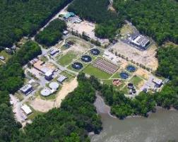
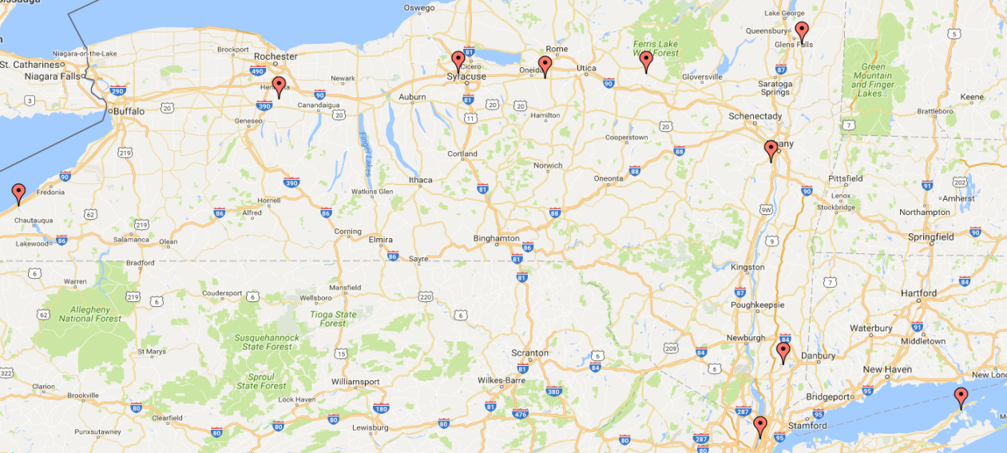
Next Steps
As a team, complete the Level of Service Profile using the Level of Service Toolbox item and the knowledge gained in this workshop.
NYSDEC Level of Service Workshop adapted from Hazen’s NYSEFC & NYSDEC Municipal Sewage System Asset Management Pilot Program Levels of Service Workshop, September 2017.

